Slide 1
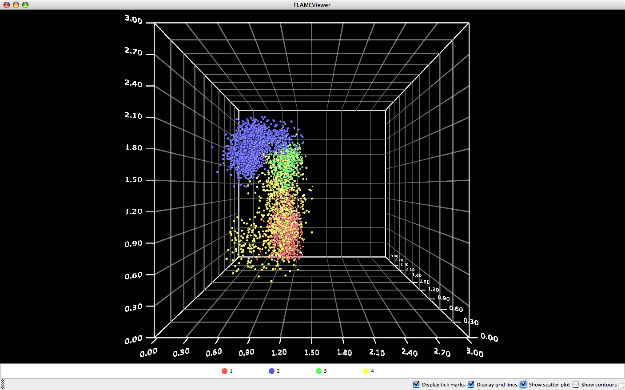
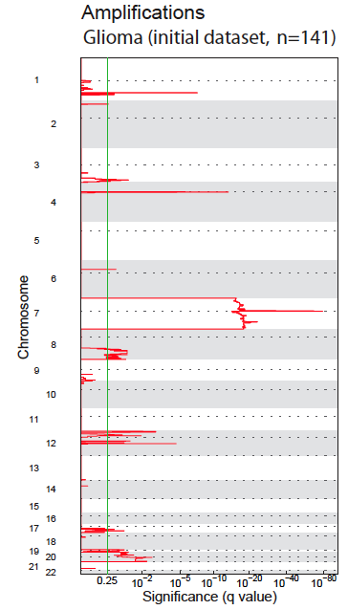
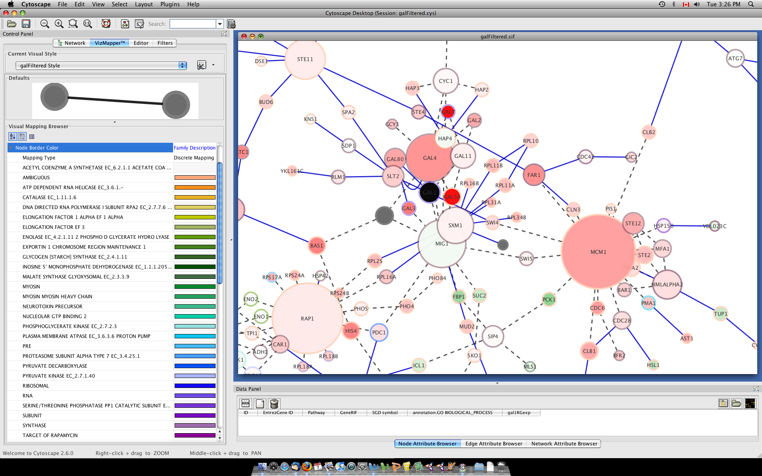
Other GenePattern Features
Flow Cytometry
Sequence Variation
Analysis
Proteomics
Network Analysis
Notes:
1

Slide 2

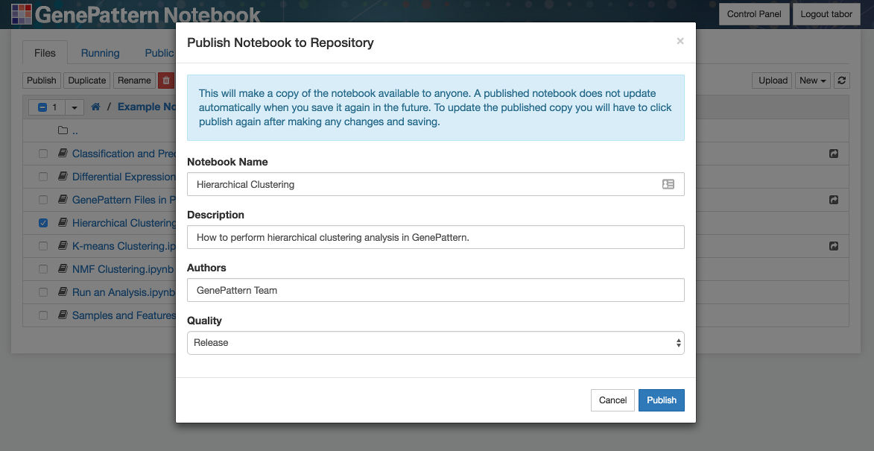
Publish Your Notebooks
You can publish your own notebooks to the GenePattern Notebook Repository.
Share notebooks with others.
Notes:
Earlier we walked through browsing the list of available public notebooks.
.
The notebooks in this list were contributed by some combination of the GenePattern team and the GenePattern Notebook community.
.
In fact, anyone can share their own public notebooks in this way. This is a good way to share your research with others. It can be used to accompany a paper or other publication.

Slide 3
GenePattern Python Library
Control a GenePattern server via Python
Automatic integration with GenePattern cell data
import gp
# Create a GenePattern server proxy instance
gpserver = gp.GPServer('http://localhost:8080/gp','myusername', 'mypassword')
# Obtain GPTask by module name
module = gp.GPTask(gpserver, "PreprocessDataset")
# Load module parameter data
module.param_load()
# Create a job specification
job_spec = module.make_job_spec()
# Upload a file to the server
uploaded_file = gpserver.upload_file("file_name", "/path/to/the/file/file_name")
job_spec.set_parameter("input.filename", uploaded_file.get_url())
# Submit the job to the GenePattern server
job = gpserver.run_job(job_spec)
Notes:
Under the cover, all GenePattern cells use the GenePattern Library. This library allows a user to set analysis parameters, launch GenePattern jobs, retrieve the results and import the data in a way that can be used with other popular Python libraries.
For example, you can run an analysis in GenePattern, retrieve the results and then use that data with Python libraries such as matplotlib, scikit-learn or pandas.
That is, GenePattern doesn’t import any limitations on you. If you can write code, you can use the library to perform whatever analysis you want.
And here you can see a bit of example code up on the screen.

Slide 4
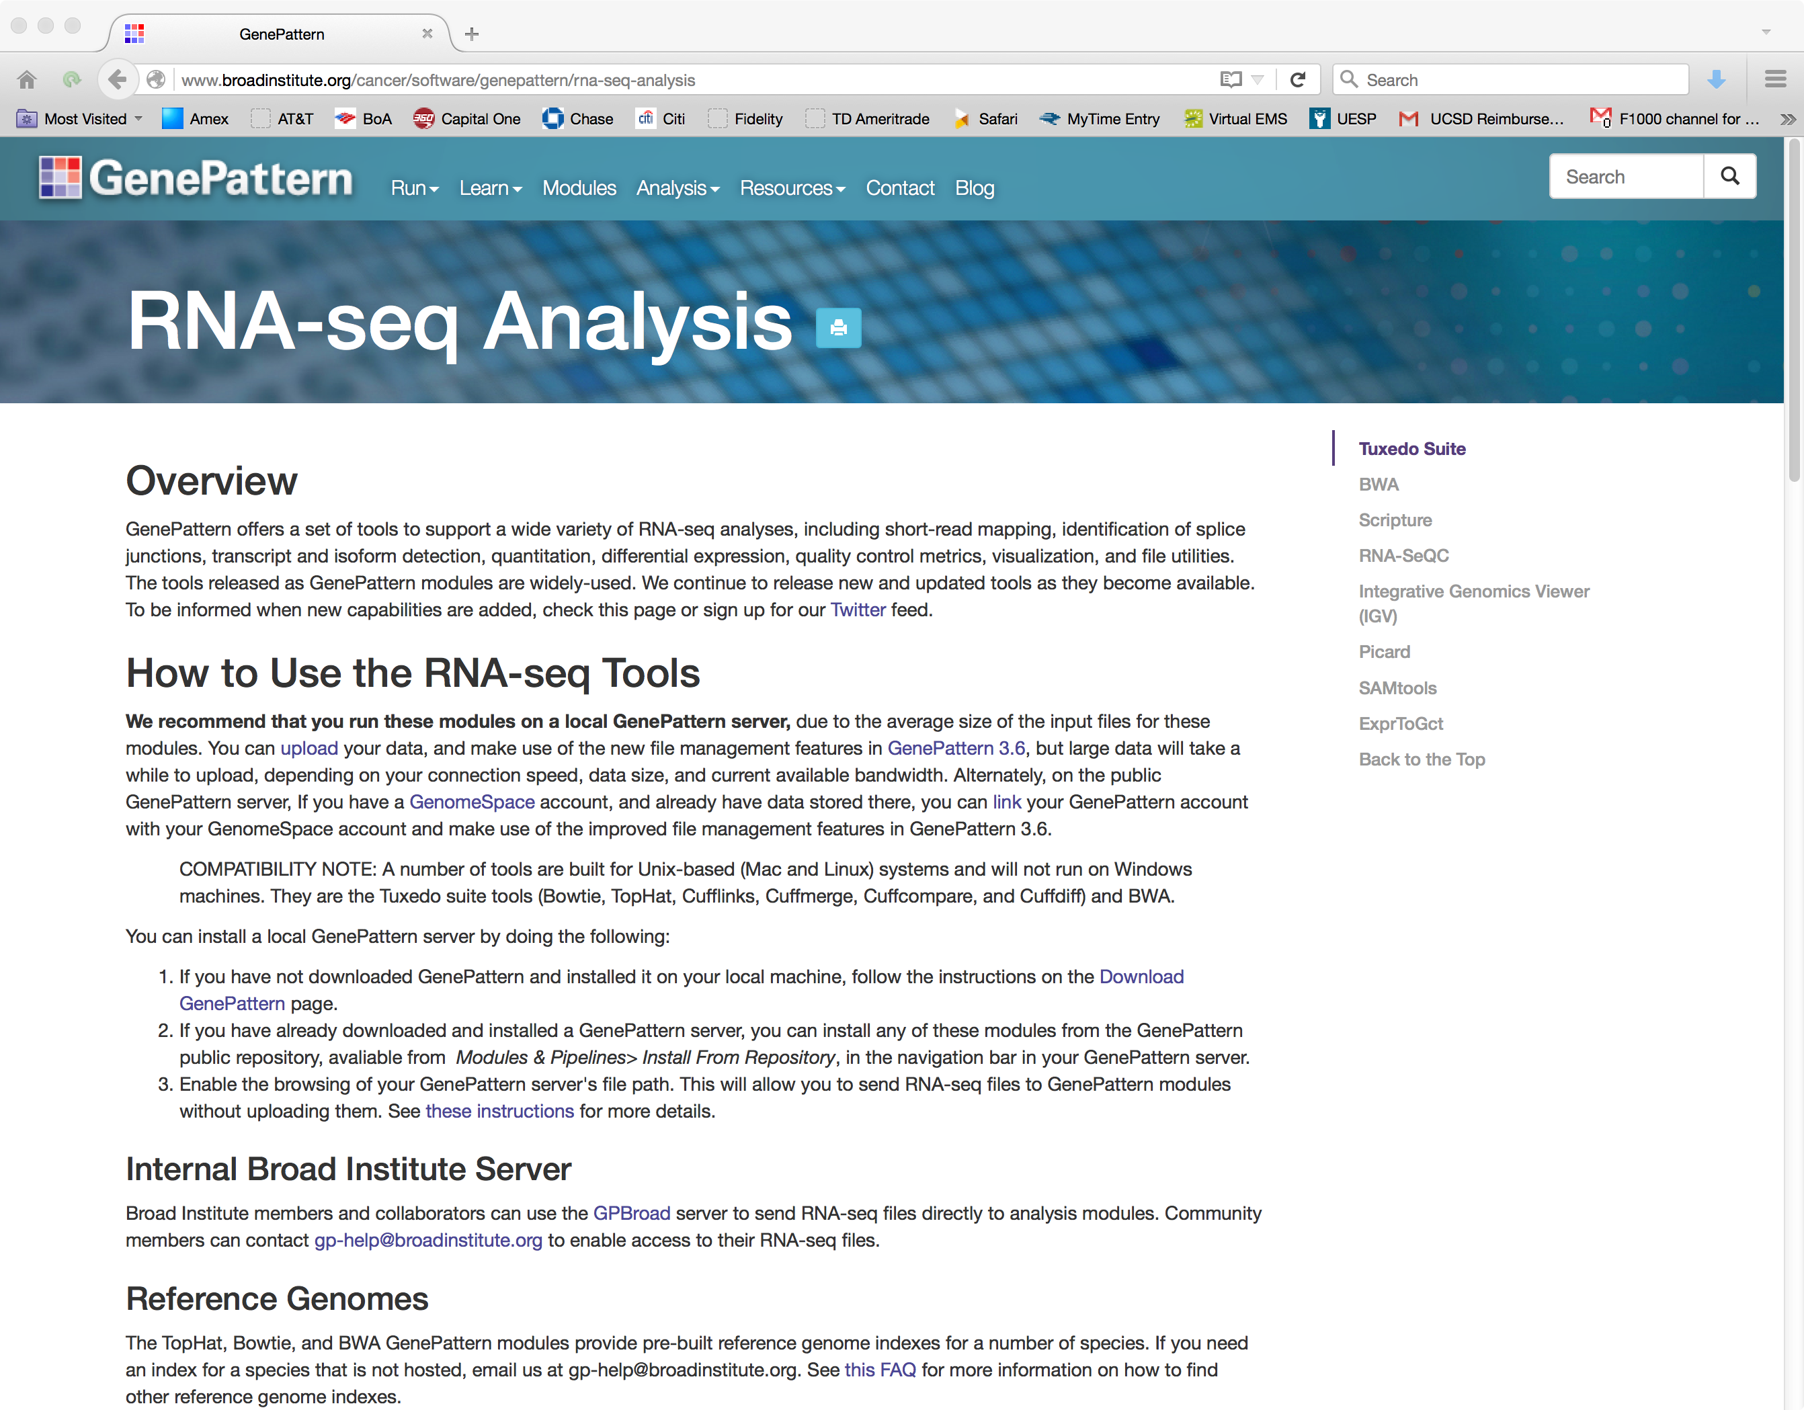
RNA-Seq in GenePattern
www.genepattern.org/rna-seq-analysis

Slide 5

Modules Supporting RNA-Seq
Differential Expression Workflow in GenePattern
* Tuxedo Suite
QC: raw sequence reads
FastQC
Trimming/Filtering
Trimmomatic
Read Alignment / Splice Detection
TopHat
*
QC: aligned reads
RNASeQC, IGV
Transcriptome Assembly
Cufflinks and Cuffmerge
*
Summarization / Quantitation
Cuffdiff and CummeRbund
DESeq2
Normalization
*
Differential Expression Analysis
Notes:
In GenePattern these are the modules you would use to get a file containing read counts.
We do not currently have HTSeq in GenePattern, but we are adding modules all the time, and welcome requests and suggestions.
Some future modules we are looking to add are HTSeq, EdgeR, RSEM and STAR.

Slide 6
Proteomics
PePPER: Landmark detection
determine the likely identification of an unknown peak based on its relative location to known peaks.
ESPPredictor
Determine optimal peptides for mass spec assay development
AuDIT
Automated Detection of Inaccurate and Imprecise Transitions in Quantitative Assays of Peptides by Multiple Reaction Monitoring Mass Spectrometry
Spectrum analysis pipeline (MALDI/SELDI)
Noise removal, Peak detection, Spectrum comparison
Notes:
We have a suite of proteomics tools, some of which are specialty algorithms for LC/MS, and others are a generic MALDI/SELDI analysis pipeline

Slide 7
SNP/Copy Number Analysis
Support for SNP chip formats
Affymetrix 10k, 50k, 500k, SNP6.0 chip sets
GISTIC: Identification of broad and focal chromosomal insertions/deletions (RAE)
Segmentation (GLAD, CBS)
Copy number estimation
Summarization
LOH determination
Notes:
Complete end-to-end SNP analysis pipeline, from preprocessing through segmentation to the identification of significantly aberrated chromosomal regions

Slide 8
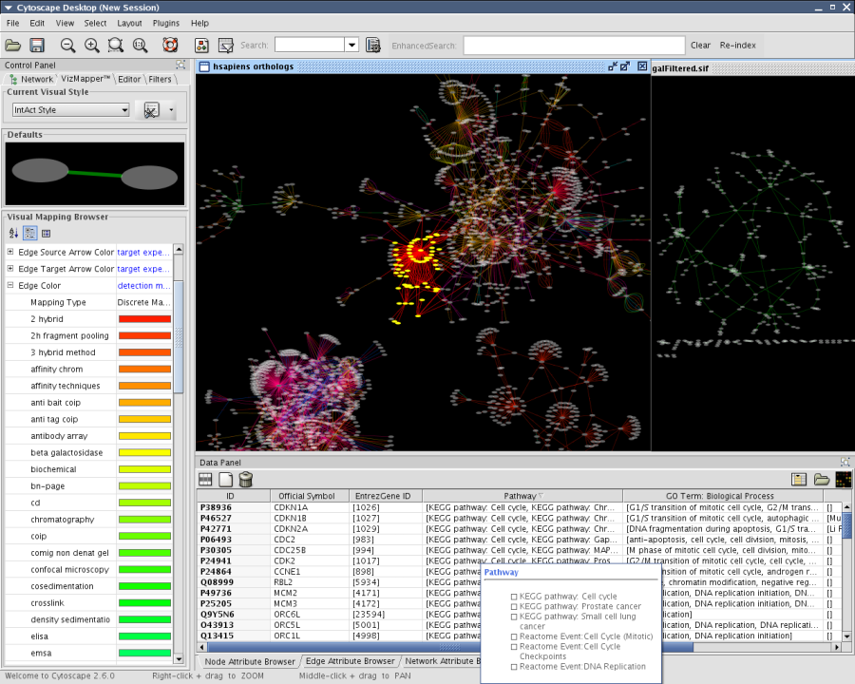
Network and Pathway Analysis
Cytoscape (UCSD)
Gene Set Enrichment Analysis
ARACNE (Columbia)
MINDY (Columbia)
www.cytoscape.org
Notes:
GenePattern also has modules to determine the enrichment of a set of genes in a dataset,
Reverse engineer regulatory networks based on gene expression,
determine the effect of transcriptional factors on putative modulators of gene expression,
And visualize networks in a number of powerful ways.
All of these analyses come from our collaborations with external partners

Slide 9
GenePattern Flow Cytometry Suite Modules contributed by British Columbia Cancer Research Center, Brinkman Lab
Quality Assessment
FCMSinglePanelQC
FlowFingerprinting
GMBTPerformQA
PlateQA
Normalization
FCSNormalization
Gating
ApplyGatingML FlowClustClassify
FlowMeansCluster FlowMergeCluster
GMBTExtractViableFlowset KMeansClassify
SamSPECTRALCluster SuggestNumberOfPopulations
Outlier Removal
FilterAutoThreshold
RemoveSaturated
Cluster Labeling
MClustClusterLabel
MClustClusterLabelBIC
Feature Extraction
FCMFeatureExtraction
FeatureSelection2C
FlowFPFeatureExtraction
Analysis
DoClassification
GMBTEvaluateViableFlowset
TrainClassifier

Slide 10
FLow analysis with Automated Multivariate Estimation: FLAME
Clustering – parametric and multivariate mixture modeling of the populations in each FACS sample
Meta-clustering – match corresponding populations from multiple samples to compare features of these matching populations
Visualization
Feature selection – identify features that distinguish populations between different classes
Classification – predict class membership for new samples based on those distinctive features
Pyne et al., PNAS 2009
Notes:
Uses EM algorithm to model cell populations
Matches populations between samples to compare their features
Identifies features that classify populations
Predicts membership for new samples
Visualizes both in a particle- and cloud-based format
We are adding modules for next-generation sequencing analysis, epigenomics, and exon array analysis
This is a lot of analyses. But what’s more important is what GenePattern lets you do with them.

Slide 11
Programming Environment
Access any GenePattern module from a programming language
GenePattern comes with libraries for Java, R, Python, MATLAB
Call a GenePattern analysis transparently - like calling a function
Notes:
11

Slide 12
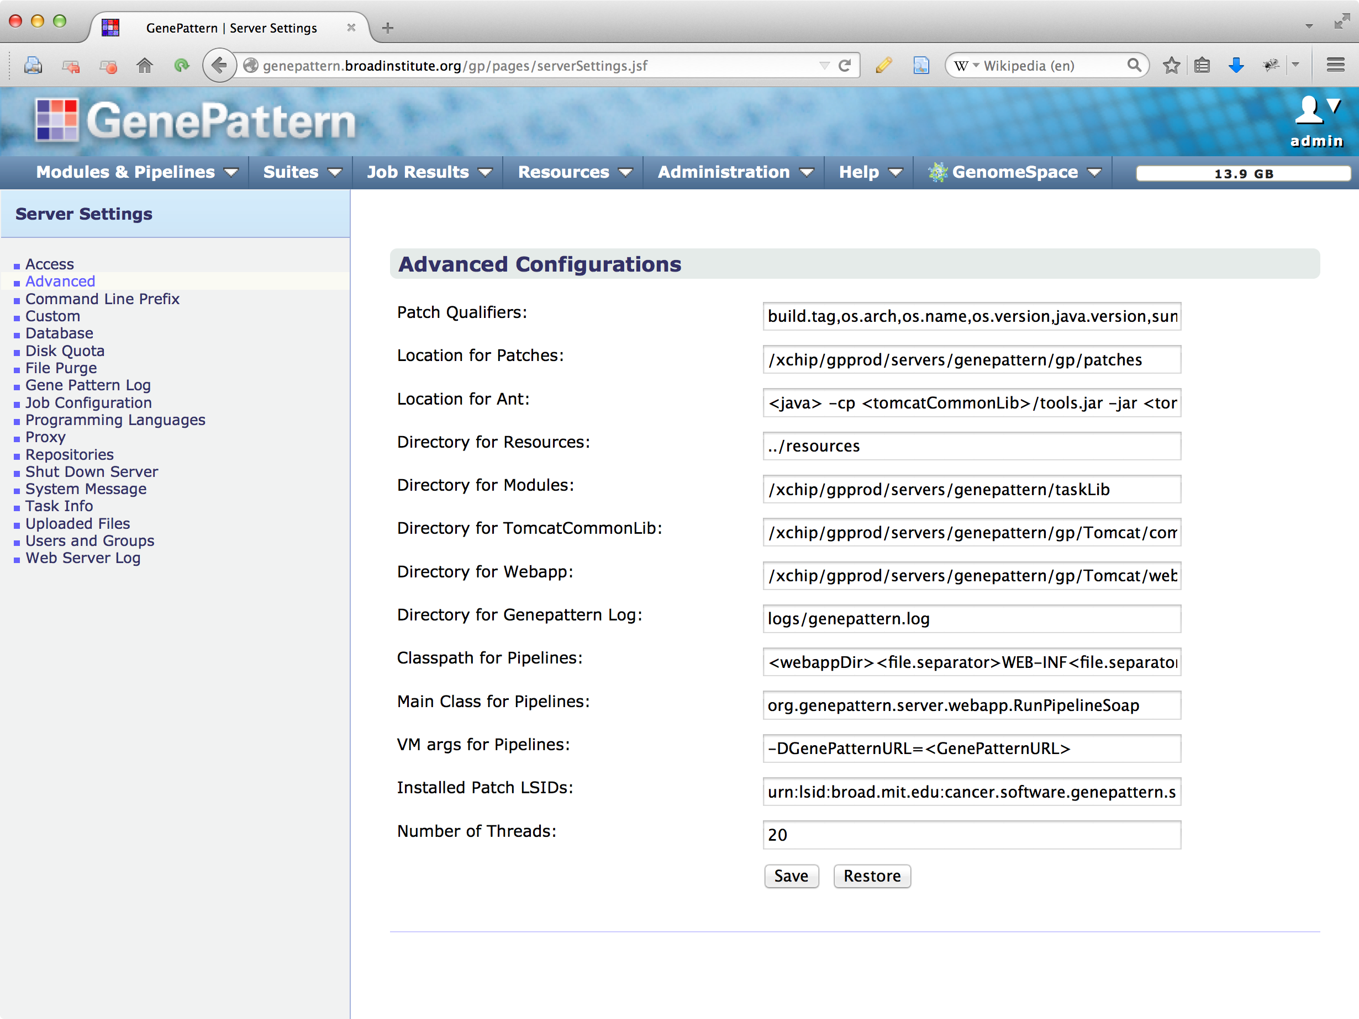
Server Administration
Notes:
12

Slide 13
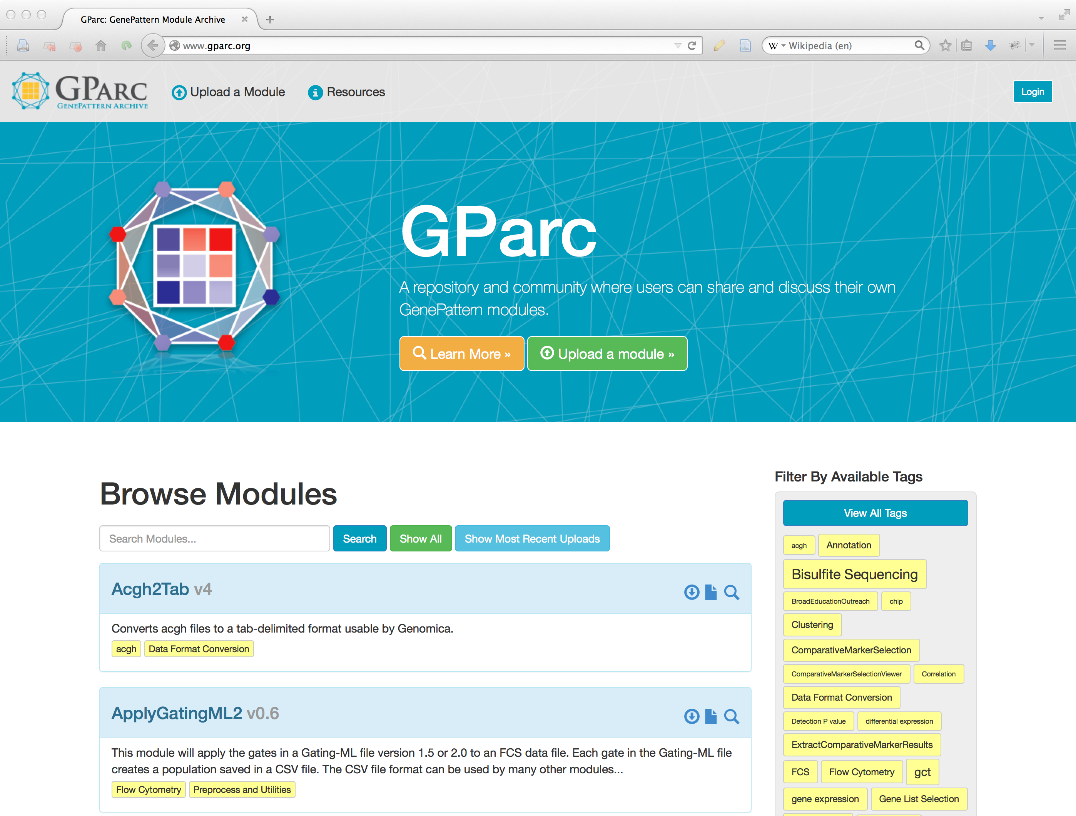
GParc: the GenePattern Archive
Find and download modules contributed by the worldwide GenePattern community
Share your own modules easily
Tag and comment on modules
Get module updates
www.gparc.org
Notes:
13

